Slide 1
Hub

Slide 2
IBM Mainframe

Slide 3




IBM Tower

Slide 4




















Instant Access Client POE+

Slide 5




















Instant Access Client

Slide 6




















Instant Access System

Slide 7










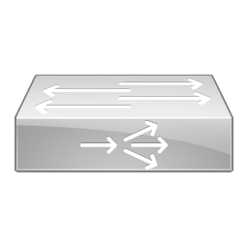
IOS SLB

Slide 8


















IP Communicator

Slide 9











ISDN Switch

Slide 10











Jbod

Slide 11











Laptop

Slide 12











Layer 3 Switch

Slide 13


Lock

Slide 14











Mars

Slide 15



















Media Control Unit

Slide 16











MGX 8000 Multiservice Switch

Slide 17











Modem

Slide 18











MUX

Slide 19











NAC Appliance

Slide 20




















NCS 2000

Slide 21




















NCS 4000

Slide 22




















NCS 4200

Slide 23




















NCS 6000

Slide 24











Net Ranger

Slide 25











Optical Amplifier

Slide 26











Optical Transport

Slide 27











PBX Switch

Slide 28


















Phone

Slide 29











Pix Firewall

Slide 30


Printer

Slide 31











Repeater

Slide 32





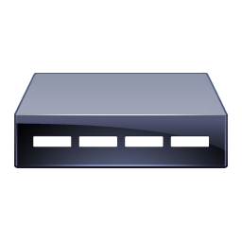




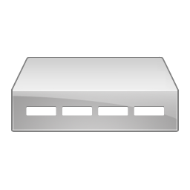
RF Modem

Slide 33


















RMA

Slide 34


















Route Switch Processor

Slide 35


















Router

Slide 36


















Router with Firewall

Slide 37











RP Router

Slide 38






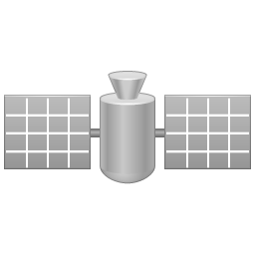




Satellite

Slide 39











Satellite Dish

Slide 40


















Server

Slide 41






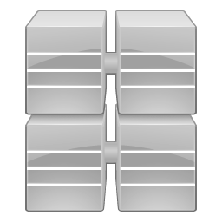




Server Farms

Slide 42











Service Module

Slide 43











Set Top Box

Slide 44


















SIP Proxy Server

Slide 45











Standard Host

Slide 46











Storage Array

Slide 47











Storage Router

Slide 48


















Switch

Slide 49











Tape Array

Slide 50











Telephony Router

Slide 51


















Telepresence Manager

Slide 52


















Telepresence 500

Slide 53


















Telepresence 1000

Slide 54

















Telepresence 3000

Slide 55


Television

Slide 56


















Terminal

Slide 57











UBR 910

Slide 58











UCS Switch

Slide 59


















Unified Border Element

Slide 60




















Unity Connection

Slide 61











Unity Express

Slide 62


















Universal Gateway

Slide 63











Vidmond

Slide 64











Virtual ACE Server

Slide 65











Virtual Nexus 7000

Slide 66




















Virtual Router

Slide 67











Virtual Server

Slide 68











Voice ATM Switch

Slide 69











Voice Gateway

Slide 70


















Voice Router

Slide 71


















Voice Switch

Slide 72


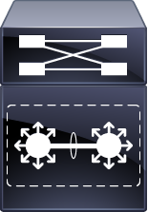

















VSS

Slide 73











Wireless Bridge

Slide 74



















Wireless LAN Controller

Slide 75











Wireless Router

Slide 76
WWW Server

Slide 77
XT30

